Slide 1


Virtual Machines & Mobile OS
UNIT V
By
R.CHITRA DEVI
AP/CSE

Slide 2

Part 1: Virtual Machines

Slide 3

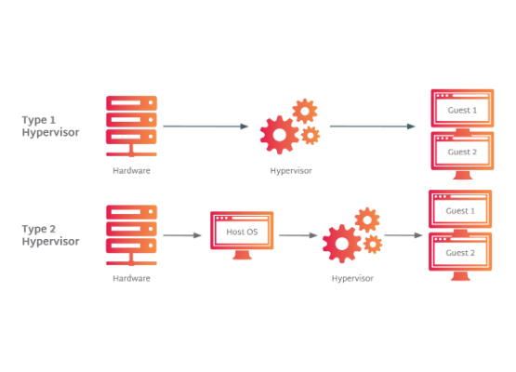
What is a Virtual Machine?
Definition
A Virtual Machine (VM) is a virtual environment that functions as a virtual computer system with its own CPU, memory, network interface, and storage, created on a physical hardware system.
It's a software construct that mimics a physical server, capable of running applications and entire operating systems in isolation.

Slide 4


Benefits and Drawbacks
Benefits
Disadvantages
•
Isolation: VMs are isolated from the host and other VMs. No data leaks.
•
Efficiency: Less efficient than real machines due to indirect hardware access.
•
Multi-OS: Run multiple, heterogeneous operating systems on the same computer.
•
Security: A VM can be infected with the weaknesses of the host machine.
•
Consolidation: Reduce costs by running many small virtual servers on one powerful physical server.
•
Hardware Access: Difficulty in directly accessing specific hardware like USB devices.
•
Management: Easy to backup, clone, and support legacy applications.
•
Disk Space: Requires large disk space for each guest OS's files.

Slide 5
A Brief History of VMs
1972: IBM announced VM/370 for the System/370, dividing mainframes into multiple virtual machines, each running its own OS.
Virtual Disks: To solve the problem of limited physical drives, IBM created "minidisks." These were virtual disks that allocated tracks on physical disks as needed.
Time-Sharing: VM/370 managed resources so every user felt they had a complete replica of the System/370, allowing different OSs to run concurrently.

Slide 6
VM Building Blocks: How It Works

Slide 7
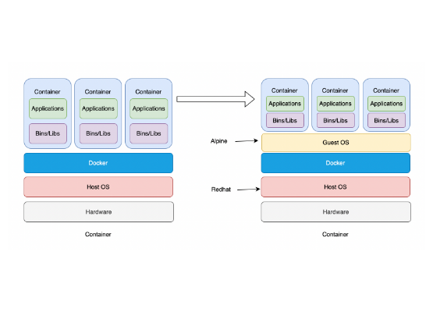
Building Block: Trap-and-Emulate
The "Trap-and-Emulate" Method
The Guest OS runs at a lower privilege level (e.g., Ring 1) than the VMM (Ring 0).
When the guest kernel attempts a privileged instruction (like setting the IDT or accessing hardware), it's an error because it's in a lower-privilege mode. This error causes a "trap" to the VMM.
The VMM gains control, emulates the action the guest *thought* it was doing, and then returns control to the guest.

Slide 8


Building Blocks: Translation & Hardware
Binary Translation
Hardware Assisted
The VMM's virtualization layer sits at the most privileged level (Ring 0). The guest OS is moved to a less privileged level (Ring 1).
Requires special CPU support (e.g., Intel VT-x, AMD-V). This creates a new "root mode" privilege level below Ring 0 for the hypervisor.
Non-virtualizable kernel code from the guest is translated "on the fly" into new instruction sequences that have the intended effect on the virtual hardware. User-level code runs directly on the CPU.
Privileged and sensitive calls from the guest OS are set to automatically trap to the hypervisor, which is more efficient than binary translation's high overhead.

Slide 9
Types of Hypervisors (VMMs)

Slide 10



Types of Hypervisors
Type 0 (Hardware)
Type 1 (Bare-Metal)
Type 2 (Hosted)
A hardware-based solution where the VMM is encoded in the firmware and loaded at boot time. It splits the system into "partitions" or "domains," each with dedicated resources.
Installed on top of a conventional OS (like Windows or macOS). It is dependent on the host OS. Examples: VMware Workstation, VirtualBox.
Software that runs directly on the host hardware (no underlying OS). Guest OSs run at a second level. Examples: VMware ESXi, Microsoft Hyper-V.

Slide 11
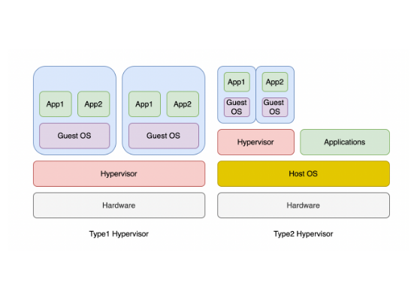
Paravirtualization
Paravirtualization
A type of virtualization where the guest operating system is *modified* to be aware that it is running in a VM.
It replaces non-virtualizable instructions with "hypercalls" that communicate directly with the hypervisor (virtualization layer). This improves performance and efficiency.
The hypervisor provides a special API rather than simulating hardware. Example: Xen.

Slide 12
Comparison: Type 1 vs. Type 2 Hypervisor
Feature | Type 1 Hypervisor | Type 2 Hypervisor
Alias | Bare Metal or Native Hypervisor | Hosted Hypervisor
Dependency | Completely independent from any OS. | Completely dependent on host OS for its operations.
Installation | Works directly on the hardware of the host. | Installed on an OS and supports other OSs above it.
Virtualization | Supports hardware virtualization. | Supports OS virtualization.
Performance | Higher performance and scalability. | Low performance due to host OS overhead.
Examples | VMware ESXi Server, Microsoft Hyper-V | VMware Workstation, Oracle VirtualBox

Slide 13
Virtualization & OS Components

Slide 14


Managing CPU & Memory
CPU Scheduling
Memory Management
A single physical CPU system acts like a multiprocessor. The VMM creates virtual CPUs (vCPUs) for each guest.
Total guest memory can exceed the physical memory. The VMM uses clever techniques:
If there aren't enough physical CPUs, the VMM uses standard scheduling algorithms to put vCPU threads on physical CPUs, ensuring fairness. Over-subscription of CPUs can slow guests.
•
Ballooning: A "balloon driver" in the guest allocates memory, forcing the guest OS to free up other pages.
•
De-duplication: The VMM finds identical memory pages (e.g., from the same OS) and maps them to a single physical page.

Slide 15
Managing I/O & Storage
I/O Management: Complicated by performance needs. The VMM provides virtualized devices to guests, using standard driver interfaces. For networking, the VMM acts as a "virtual switch" to route packets to the correct guest VM.
Storage Management: The VMM provides boot disks to guests as "disk images" (e.g., .vmdk files). These are files that live on the host OS (Type 2) or a VMM filesystem (Type 1). VMMs also provide access to network-attached storage.

Slide 16

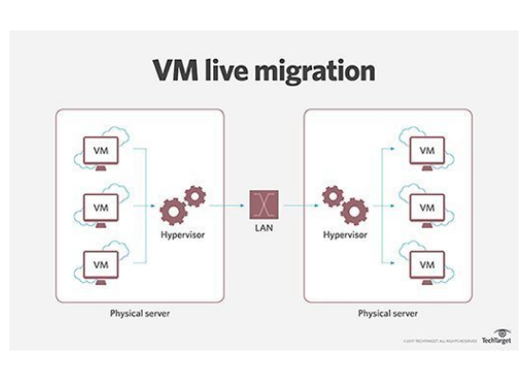
Live Migration
Live Migration
The ability to move a *running* virtual machine between physical hosts with no interruption to service. The VM remains powered on and applications continue to run.
Process:
1.
Connection is established.
2.
Read-only memory pages are sent.
3.
Read-write ("dirty") pages are sent, and the guest is marked as clean.
4.
Step 3 repeats in cycles for pages that were modified.
5.
Guest is frozen, final VCPU state and dirty pages are sent, and target is told to resume.

Slide 17
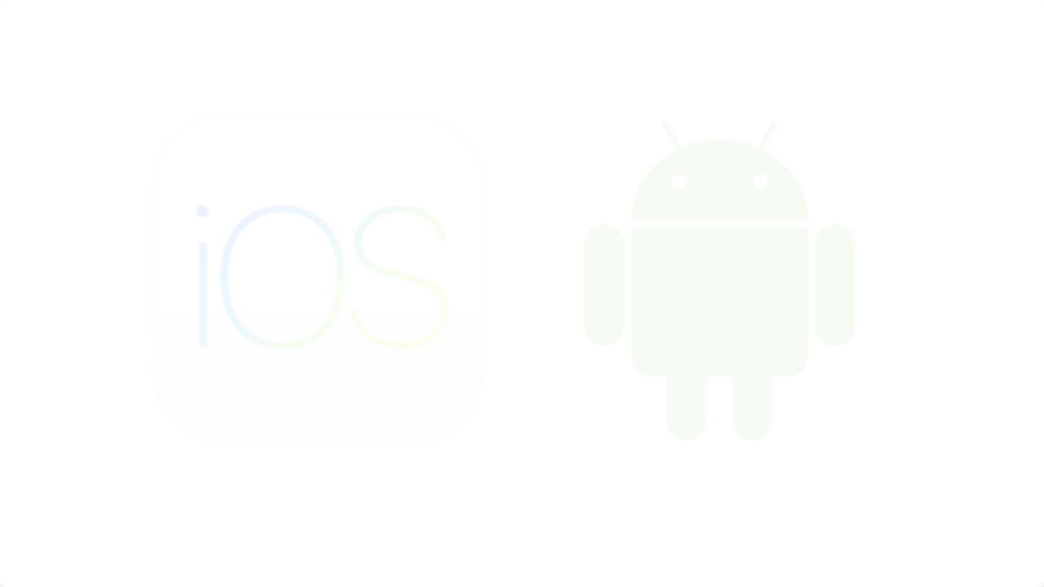
Part 2: Mobile Operating Systems

Slide 18
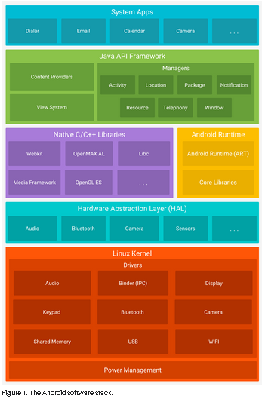
Mobile OS: Android
Android Architecture
An open-source, mobile OS developed by Google, based on the Linux 2.6 kernel.
It's a software stack including an OS, middleware, and key applications. Most app development is done in Java.
The stack consists of the Linux Kernel (drivers, power management), Libraries, Android Runtime, Application Framework, and Applications.

Slide 19



Android Core Components
App Framework
Libraries
Android Runtime
Provides high-level services like Activity Manager (manages app lifecycle), Content Providers (data sharing), and Notification Manager.
A set of C/C++ libraries including: SQLite (database), WebKit (browser engine), OpenGL ES (graphics), and Media Framework (audio/video).
Includes Core Java libraries and the Dalvik Virtual Machine. Dalvik is a register-based VM optimized for mobile with a small footprint.

Slide 20
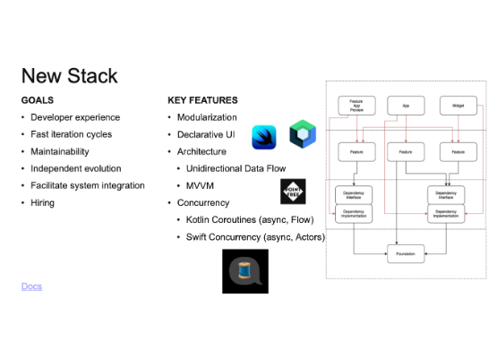
Mobile OS: iOS
iOS Architecture
iOS is the operating system for iPhone, iPad, and iPod touch. It acts as an intermediary between the hardware and the apps. Apps *do not* talk to hardware directly.
It is a layered architecture:
•
Cocoa Touch: Key frameworks for building apps (UI, multitasking, notifications).
•
Media Layer: Graphics, audio, and video technologies.
•
Core Services: Fundamental system services (iCloud, location, networking).
•
Core OS: Low-level features (security, file system, hardware).

Slide 21
Comparison: Android OS vs. iPhone OS
Feature | Android OS | iPhone OS (iOS)
Internal Memory | Limited default memory can be a "big headache". | Good internal memory; user has choice of different sizes.
External Memory | Supports external SD cards to store photos, media, etc. | No external expandable memory.
File Transfer | Easy. Plug and transfer data in flash drive mode. | Synchronization is "just like iPods".
Notifications | Broadcasts system-wide notifications in cascade windows. | Push notifications. Server pushes data (saves power).
Hardware Buttons | Menu and back buttons may not always do the same thing. | One button for one clear function. Menu/back are consistent.

